Slide 1
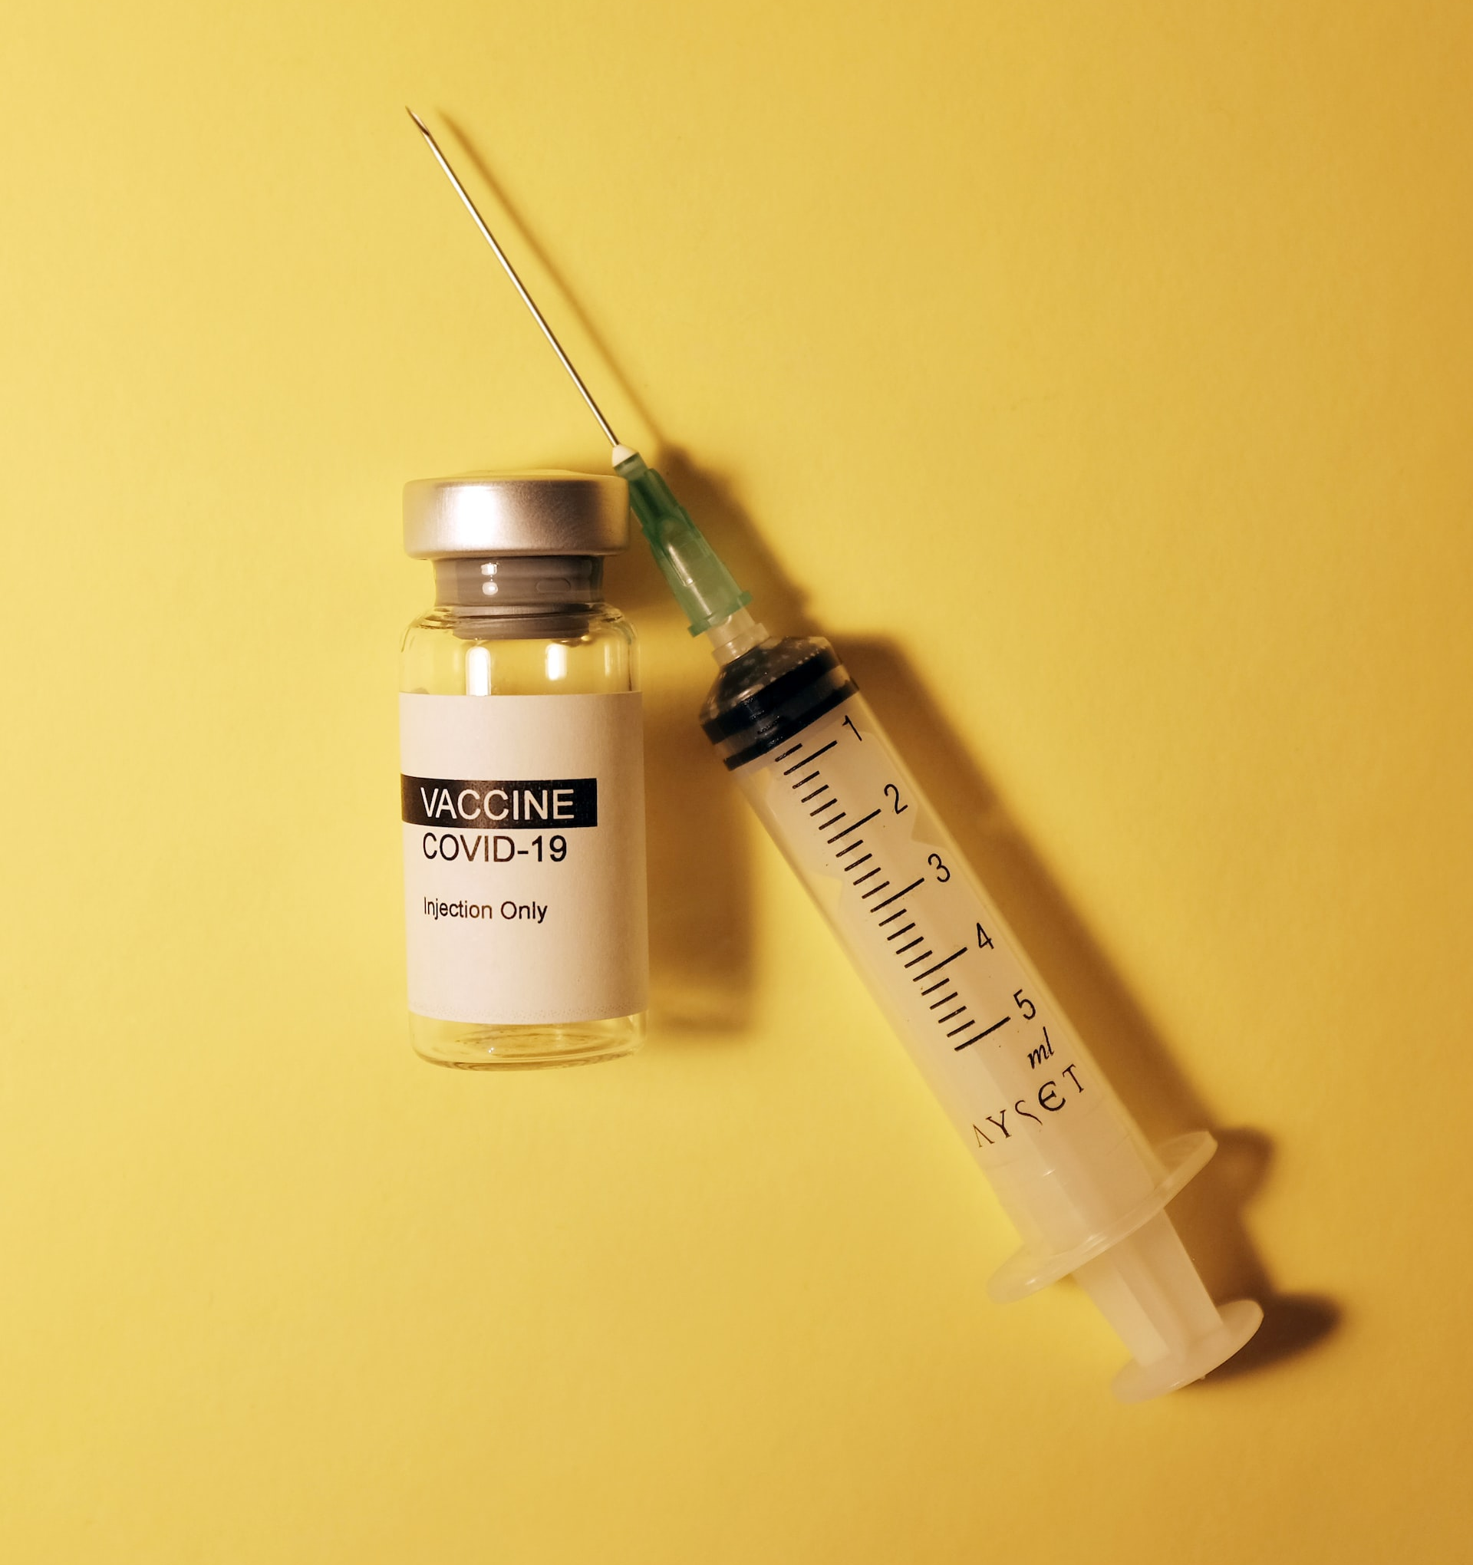
Coronavirus & Vaccine Hesitancy
MACHINE LEARNING approach to predicting vaccine hesitancy and uptake

Slide 2
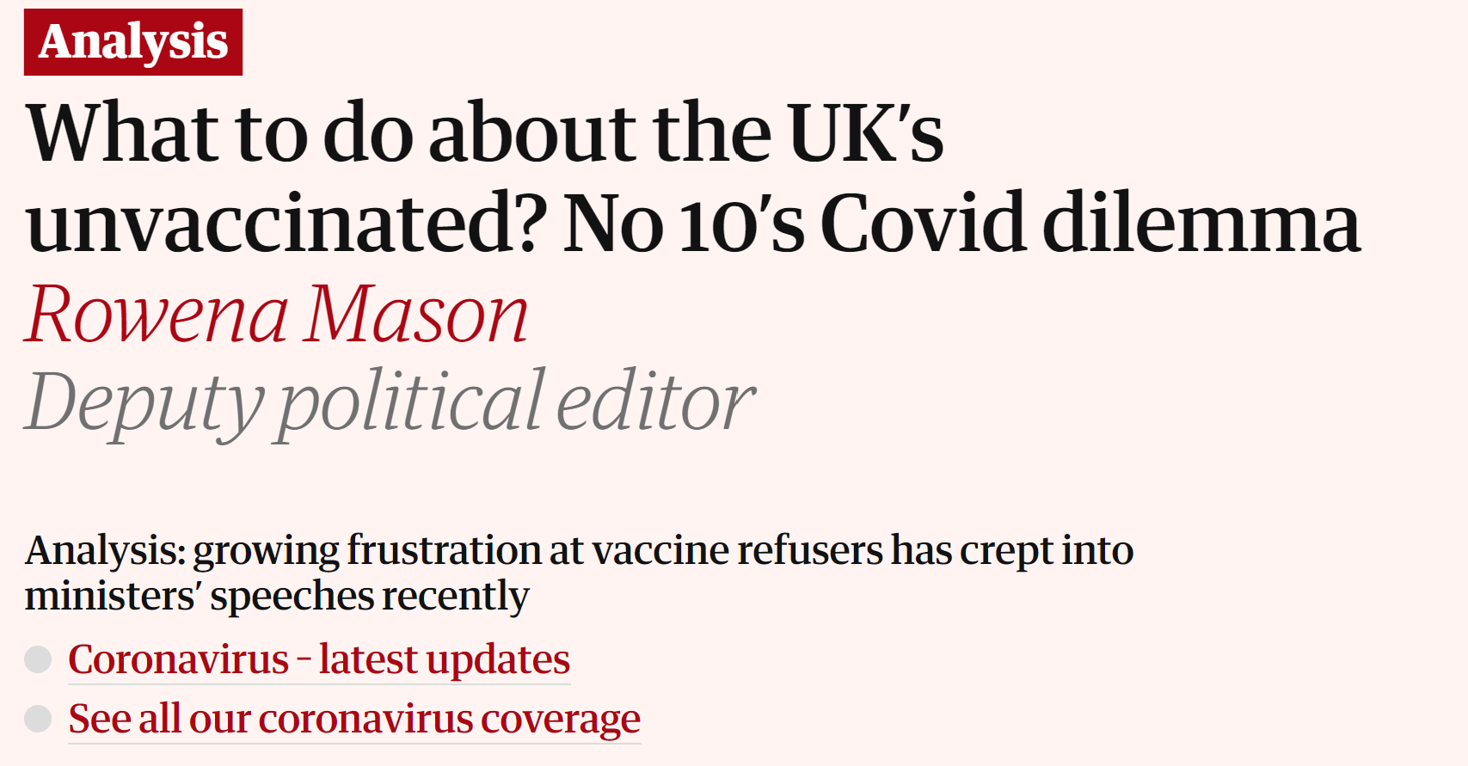
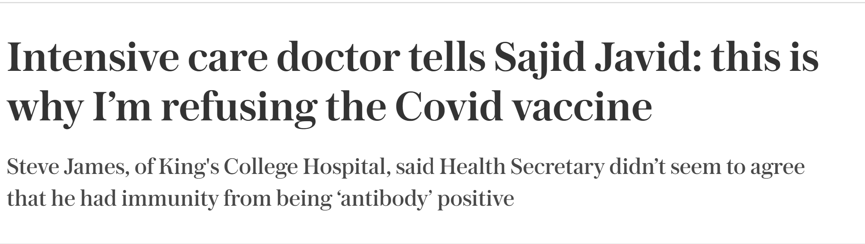
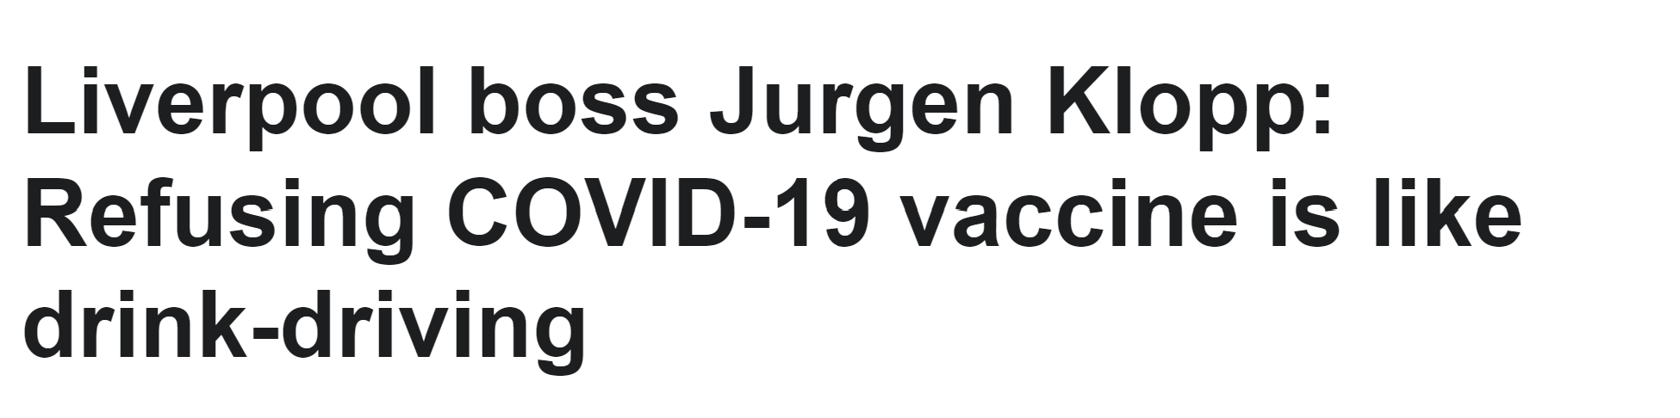
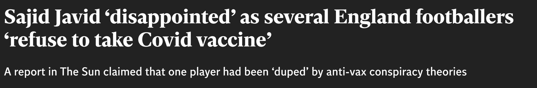
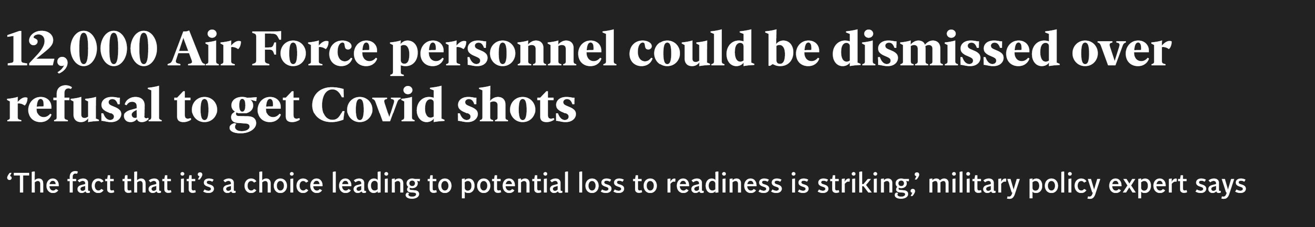
BACKGROUND
Vaccine hesitancy has increased across the developed world
Coronavirus pandemic further highlighted vaccine hesitancy issues
Research necessary to inform policy interventions

Slide 3
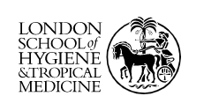

Two nationally representative surveys with UK adults
DATA SOURCE
Data collected via online survey
Two datasets, one per wave in CSV Format
24th September – 10th October 2020
Raw data provided by ORB International and LSHTM
Wave 1
N = 17002 (Pre – cleaning)
N = 9587 (Post-cleaning)
9th – 27th April 2021
Wave 2
N = 16610 (Pre – cleaning)
N = 8310 (Post-cleaning)

Slide 4
OBJECTIVE
Data Cleaning
Data Exploration
W1 Intention Model
W2 Intention Model
W2 Uptake Model
Outliers
Null Values
Recoding
Wave comparison
Willingness/uptake patterns
Intention Target
Demographics
Emotion scale
Knowledge scale
Intention Target
Demographics
Emotion scale
Knowledge scale
Voting intention
Fake news identification
Uptake Target
Predicted intention
Demographics
Emotion scale
Knowledge scale
Voting intention
Fake news identification
Does willingness indicate actual uptake?

Slide 5
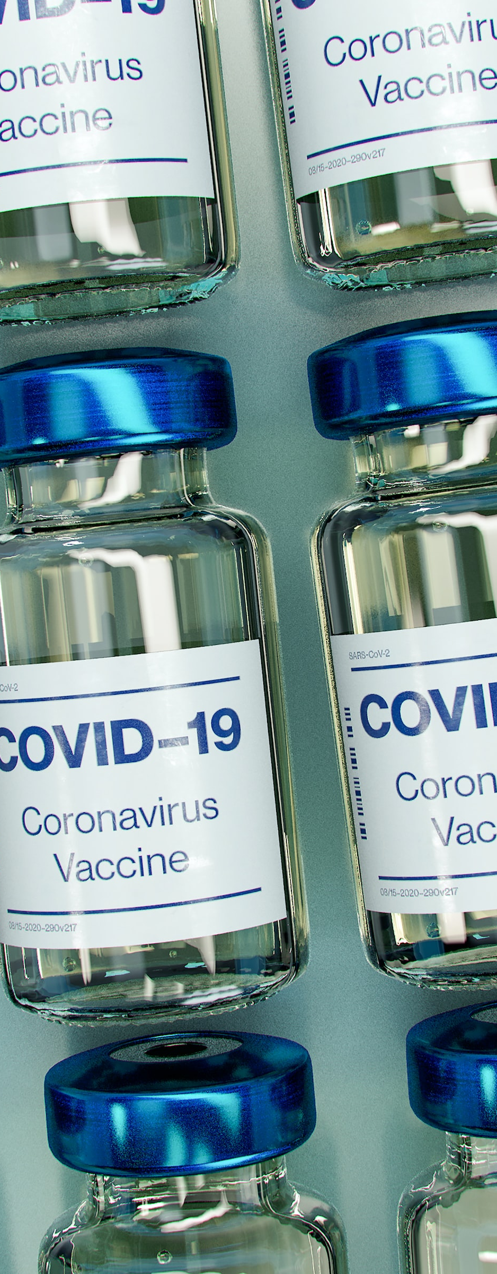
Data Summary
Source, cleaning and exploratory analysis

Slide 6
Willingness
DATA CLEANING
Uptake
Demographic Information
Remove Null Values (Non response)
Recoding/Regrouping variables
Dummification of categorical variables
Creation of composite variables using ‘Principal Component Analysis’
Class balancing using ‘SMOTE Oversampling’
Emotional Measures
Knowledge Measures
Media Trust/Usage
Identification of Fake News Headlines
Voting Intention

Slide 7
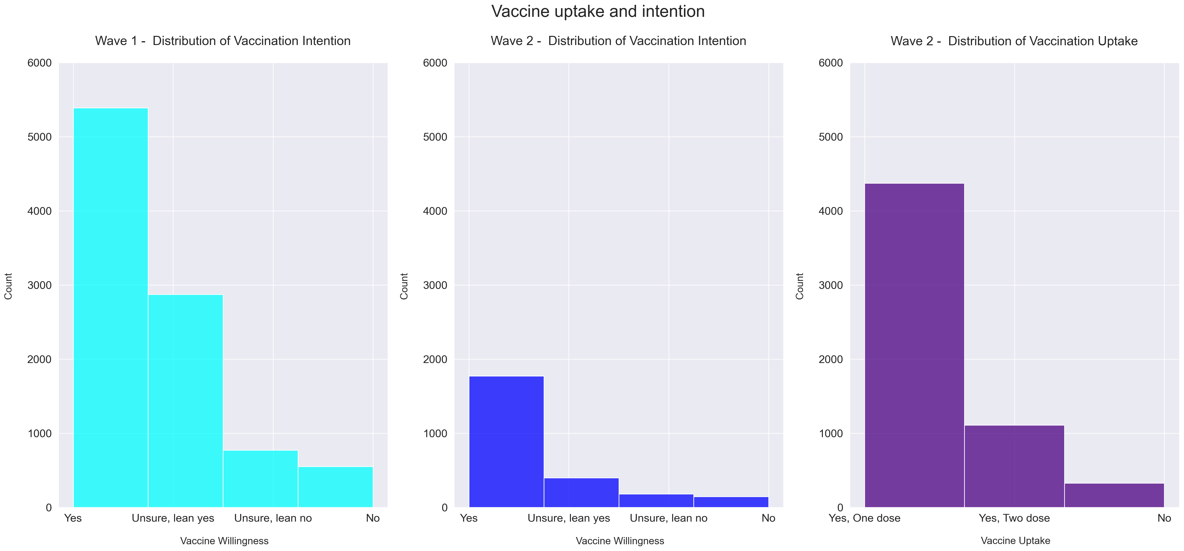
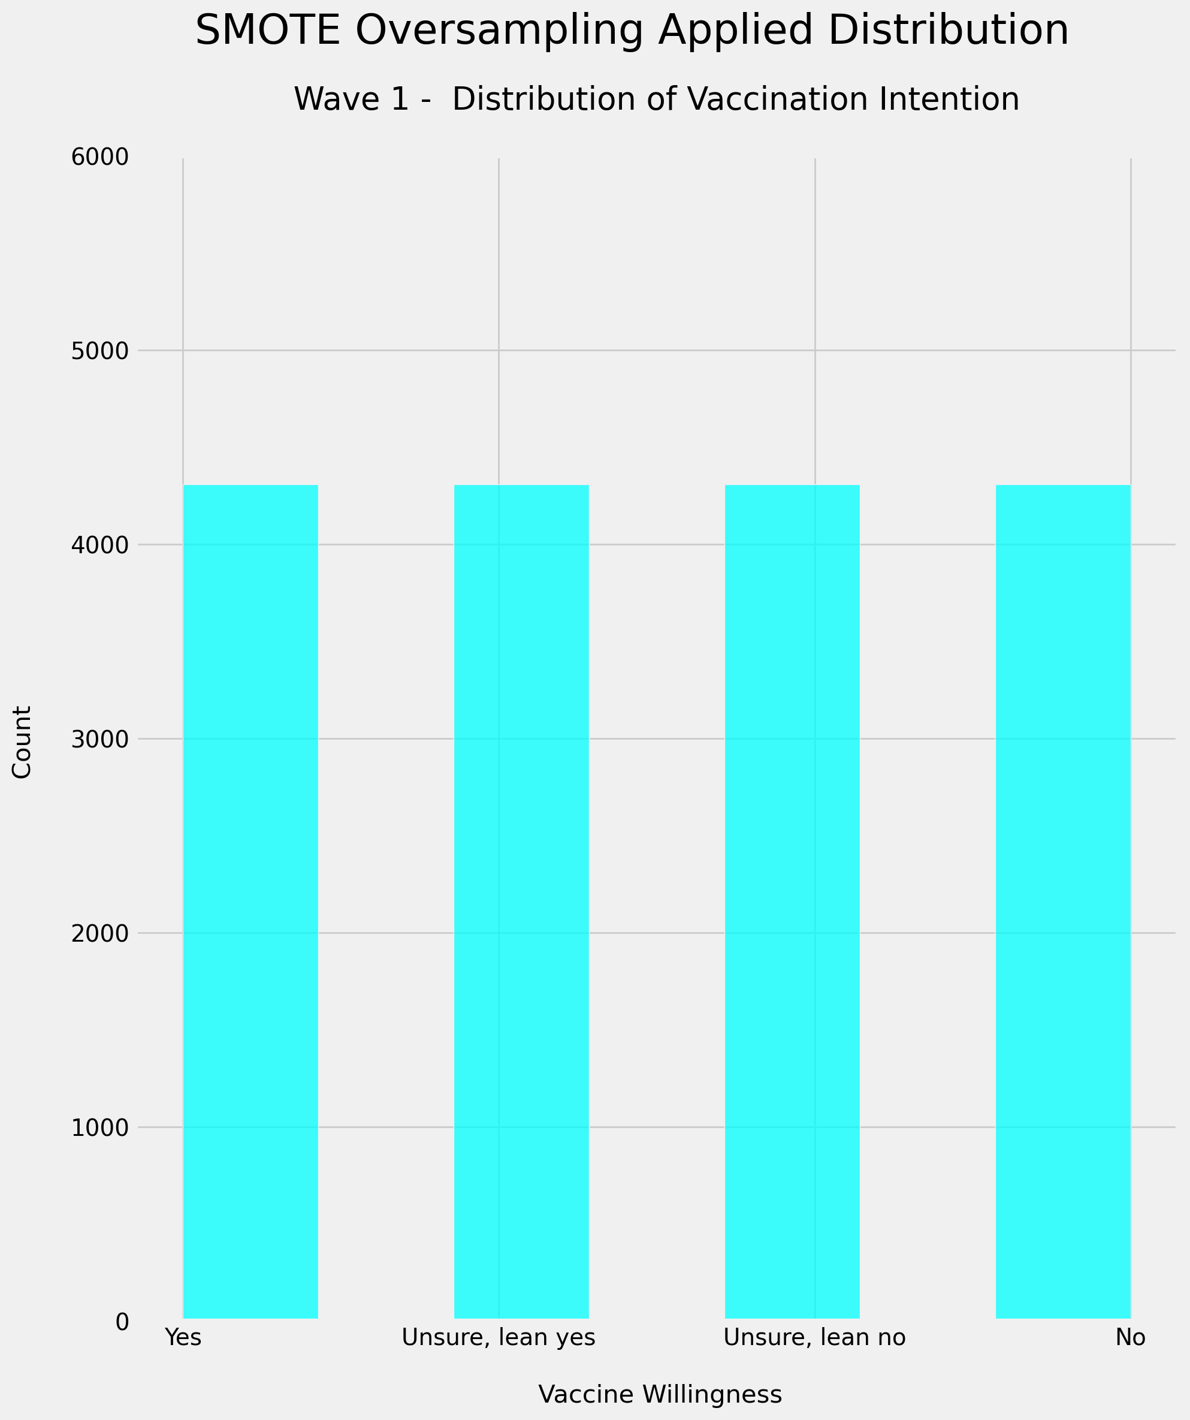
DATA EXPLORATION - Target
Minority classes are the classes of particular interest
Class imbalance addressed using ‘SMOTE Oversampling’

Slide 8
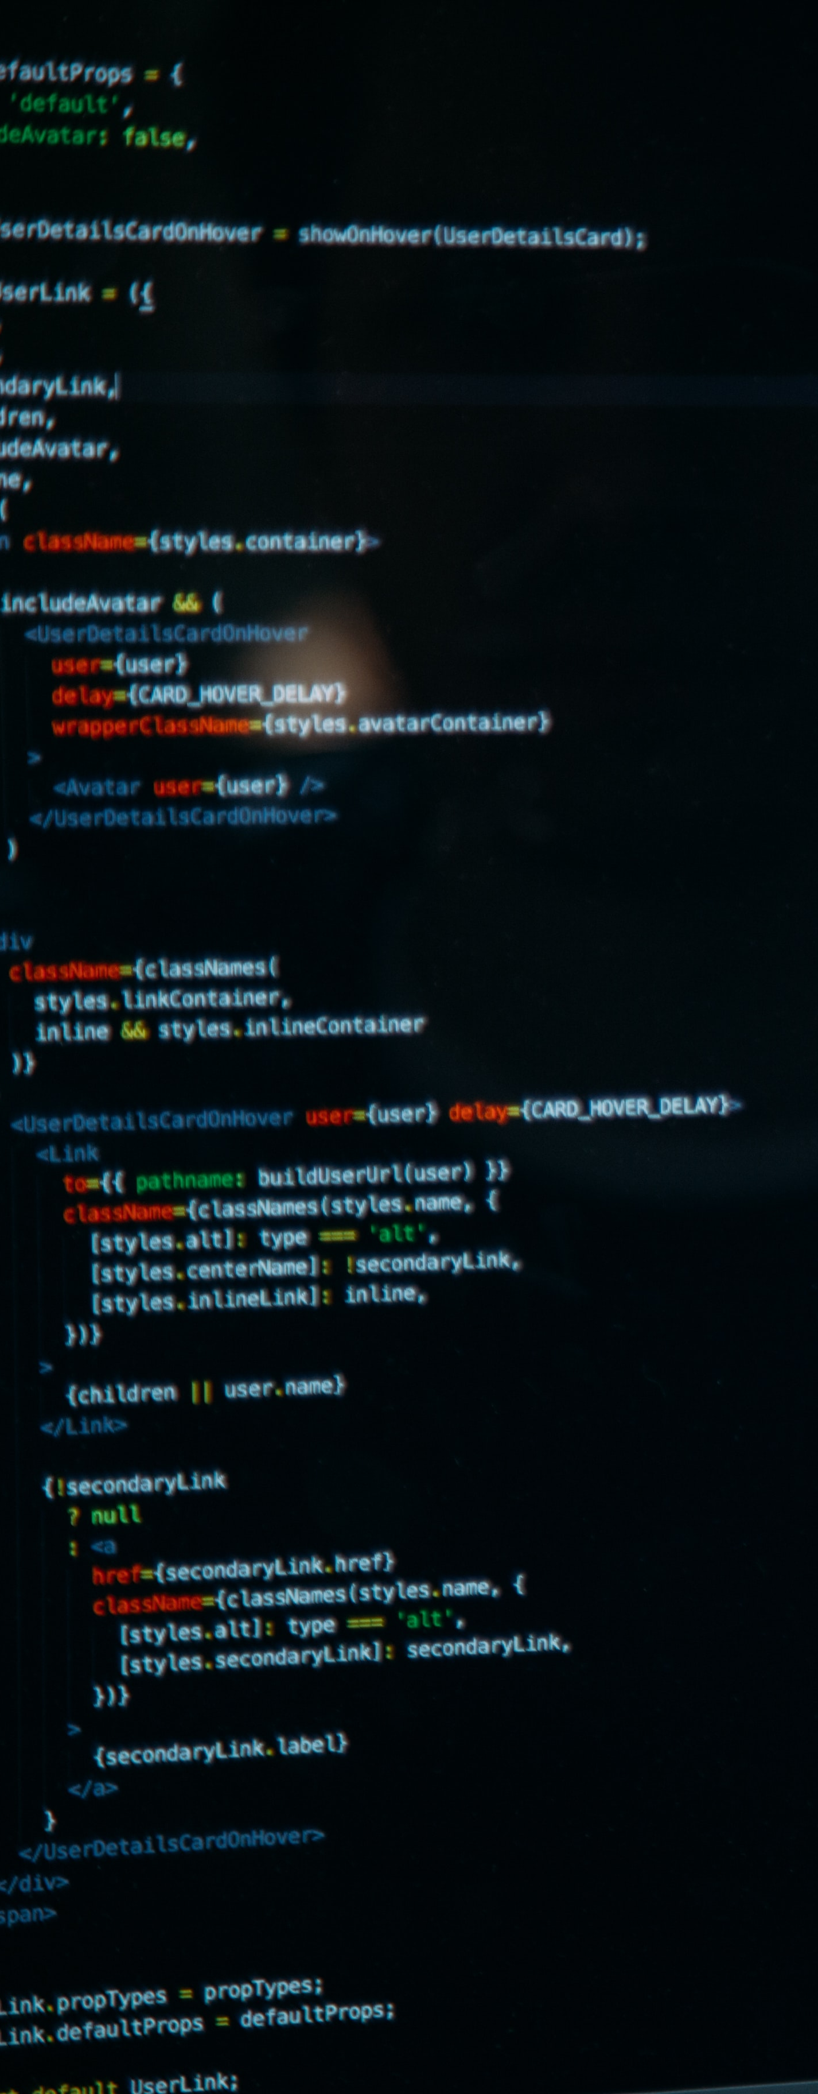
Modelling
Intention, uptake predictions & metrics

Slide 9
WAVE 1 – Willingness
 | Precision (% correct predictions out of total class prediction) | Recall % correct predictions out of true class values | F1 – Score (Composite Precision/recall measure) | Support (Total observations)
Yes, definitely willing | 0.7 | 0.65 | 0.67 | 1078
Unsure, leaning towards yes | 0.35 | 0.17 | 0.23 | 575
Unsure, leaning towards no | 0.14 | 0.26 | 0.18 | 155
No, definitely not willing | 0.21 | 0.63 | 0.31 | 110
Accuracy |  |  | 0.47 | 1918
Macro Avg | 0.35 | 0.43 | 0.35 | 1918
Weighted Avg | 0.52 | 0.47 | 0.48 | 1918
How do we interpret this information!?

Slide 10
WAVE 1 – Willingness
 | Precision (% correct predictions out of total class prediction) | Recall % correct predictions out of true class values | F1 – Score (Composite Precision/recall measure) | Support (Total observations)
Yes, definitely willing | 0.7 | 0.65 | 0.67 | 1078
Unsure, leaning towards yes | 0.35 | 0.17 | 0.23 | 575
Unsure, leaning towards no | 0.14 | 0.26 | 0.18 | 155
No, definitely not willing | 0.21 | 0.63 | 0.31 | 110
Accuracy |  |  | 0.47 | 1918
Macro Avg | 0.35 | 0.43 | 0.35 | 1918
Weighted Avg | 0.52 | 0.47 | 0.48 | 1918
PRIORITY SUCCESS METRIC IS RECALL
MOST IMPORTANT TO IDENTIFY VACCINE SKEPTICS
RISK CAUSED BY MISCLASSIFICATION OF WILLING IS LOW

Slide 11

WAVE 1 – Willingness
 | Precision (% correct predictions out of total class prediction) | Recall (% correct predictions out of true class values) | F1 – Score (Composite Precision/recall measure) | Support (Total observations)
Yes, definitely willing | 0.7 | 0.65 | 0.68 | 1078
Unsure, leaning towards yes | 0.36 | 0.18 | 0.24 | 575
Unsure, leaning towards no | 0.14 | 0.26 | 0.18 | 155
No, definitely not willing | 0.21 | 0.63 | 0.31 | 110
Accuracy |  |  | 0.48 | 1918
Macro Avg | 0.35 | 0.43 | 0.35 | 1918
Weighted Avg | 0.52 | 0.48 | 0.48 | 1918
The model only correctly predicts a quarter of those who are truly ‘unsure but leaning towards no’…
… but correctly predicts 6 out of every 10 people who are ‘definitely not willing’ to take the vaccine

Slide 12

WAVE 1 – Willingness
 | Precision (% correct predictions out of total class prediction) | Recall % correct predictions out of true class values | F1 – Score (Composite Precision/recall measure) | Support (Total observations)
Yes, definitely willing | 0.7 | 0.65 | 0.68 | 1078
Unsure, leaning towards yes | 0.36 | 0.18 | 0.24 | 575
Unsure, leaning towards no | 0.14 | 0.26 | 0.18 | 155
No, definitely not willing | 0.21 | 0.63 | 0.31 | 110
Accuracy |  |  | 0.48 | 1918
Macro Avg | 0.35 | 0.43 | 0.35 | 1918
Weighted Avg | 0.52 | 0.48 | 0.48 | 1918
Of the model’s ‘Unsure, leaning towards no’ predictions, only 14% are correct.
… while only two in 10 of the model’s ‘definitely not willing’ predictions are correct.

Slide 13
WAVE 2 – Willingness
 | Precision (% correct predictions out of total class prediction) | Recall % correct predictions out of true class values | F1 – Score (Composite Precision/recall measure) | Support (Total observations)
Yes, definitely willing | 0.89 | 0.77 | 0.82 | 355
Unsure, leaning towards yes | 0.36 | 0.28 | 0.31 | 80
Unsure, leaning towards no | 0.20 | 0.47 | 0.28 | 36
No, definitely not willing | 0.23 | 0.38 | 0.29 | 29
Accuracy |  |  | 0.64 | 500
Macro Avg | 0.42 | 0.47 | 0.43 | 500
Weighted Avg | 0.72 | 0.64 | 0.67 | 500
The model correctly predicts about a half of those who are truly ‘unsure but leaning towards no’…
… but has gotten worse at predicting those ‘definitely not willing’. It now only predicts 4 out of every 10 of this group

Slide 14
WAVE 1
WAVE 2
WAVE 2
Intention
Intention
Uptake
Wave 2 create a model to predict uptake
Create the model
Refine the model
Create intention predictions
Use previous model’s intention predictions to explore relationship between willingness and uptake

Slide 15
WAVE 2 – Uptake
 | Precision (% correct predictions out of total class prediction) | Recall % correct predictions out of true class values | F1 – Score (Composite Precision/recall measure) | Support (Total observations)
No, haven’t taken vaccine | 0.19 | 0.70 | 0.30 | 66
Yes, have had at least one shot | 0.98 | 0.82 | 0.89 | 1096
Accuracy |  |  | 0.81 | 1162
Macro Avg | 0.58 | 0.76 | 0.60 | 1162
Weighted Avg | 0.93 | 0.81 | 0.86 | 1162
The model correctly predicts 7 out 10 of those who have not taken the vaccine
… And correctly predicts about 8 out of 10 of those who have taken the vaccine
But there’s still a lot of ‘wastage’. To correctly identify these 7 out of 10 people, we need to case a large net and only 2 in 10 of these ‘haven’t taken the vaccine’ predictions are actually correct!

Slide 16
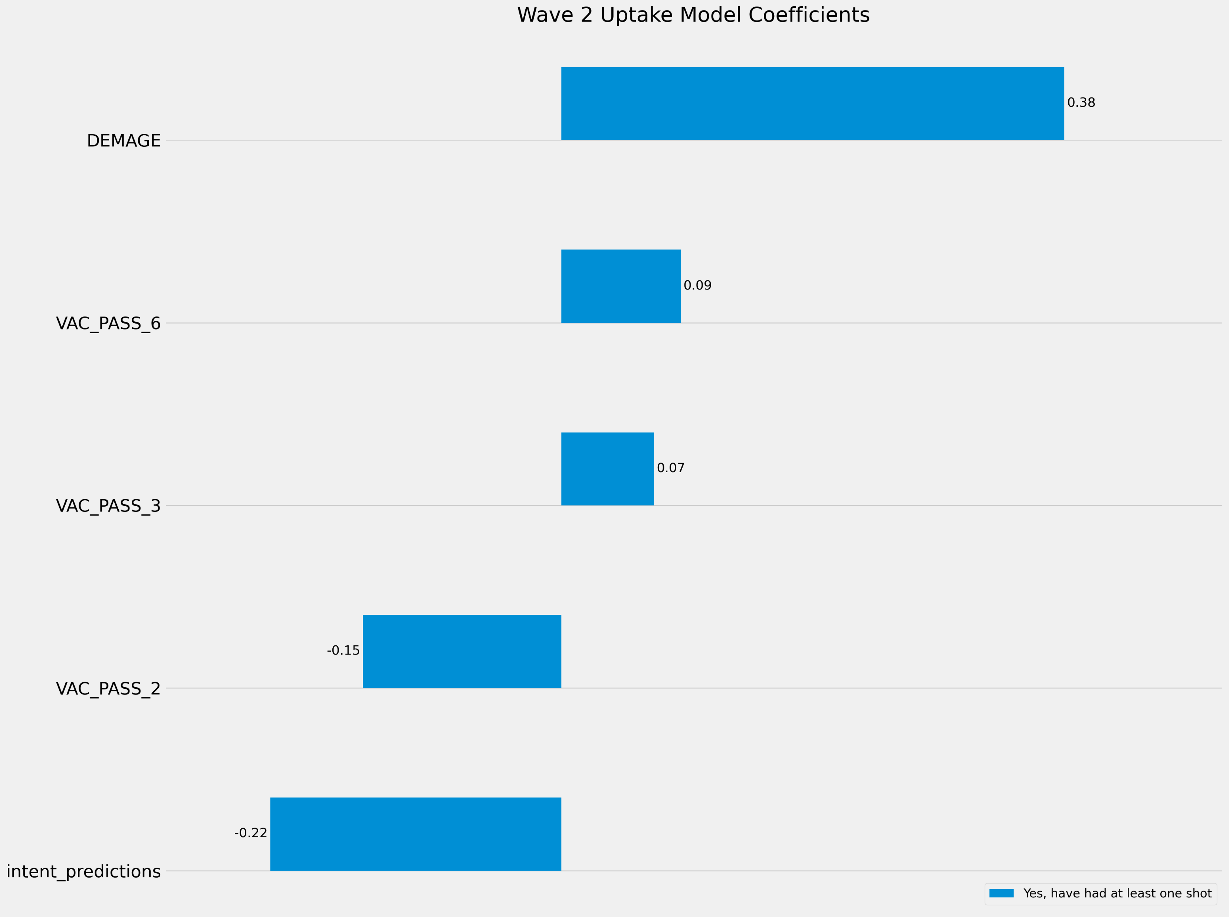
WAVE 2 – Uptake
Age emerges as the strongest predictor of likelihood of vaccine uptake
Lower self-reported willingness/intention to take the vaccine is associated with lower probability of having taken the vaccine

Slide 17
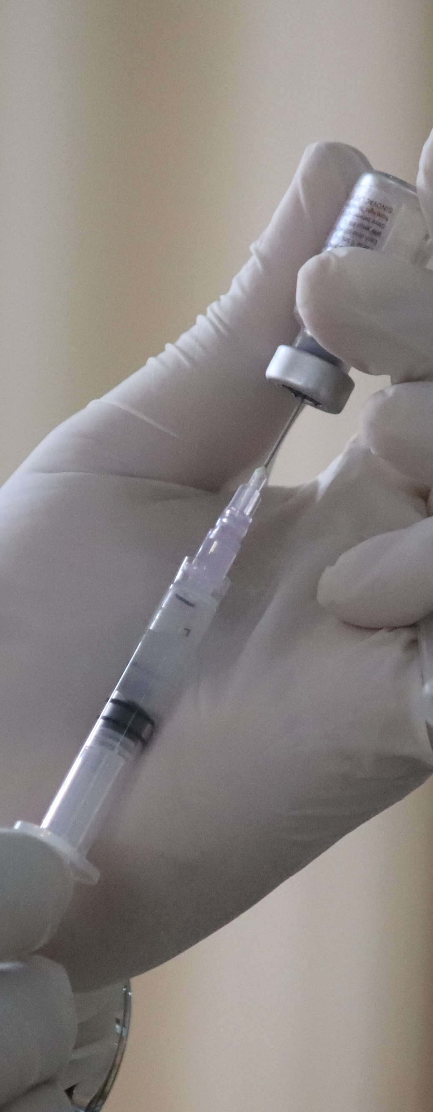
Conclusions
FINDINGS, LIMITATIONS & NEXT STEPS

Slide 18
Conclusions
Intention/Willingness models don’t tend to generalize well over time – indicates a highly changeable context
Age is an important factor in predicting uptake (but the age-based vaccine rollout is a factor here)
Underlying features likely drive both intention/willingness and uptake
Attitudinal factors (knowledge, emotion, trust in media) are important predictors of intent/willingness
Intention/Willingness to take vaccine does appear to translate into uptake behaviour

Slide 19



Highly changeable context means models don’t generalize well over time
Limitations
The intention model’s accuracy is poor – this may limit our confidence in drawing conclusions about the impact of intention on uptake
Target class imbalance is severe, and reduces the models’ accuracy
Non-response throughout the questionnaire significantly reduced sample size
Features included are limited – results suggest further underlying attitudinal factors likely exist
Next Steps
Subsequent waves of research may help to improve predictive power of models over time, particularly w.r.t uptake
Using new features may help to improve models’ predictive power – including:
Measures of exposure to specific conspiracy theory social media channels
Measures of wider vaccine hesitancy (not limited to COVID)
Broader attitudinal measures around adjacent issues – climate change, political values, other conspiracy theories

